Slide 1


BASIC ELECTRONICS AND ELECTRICAL ENGINEERING
BY- CHANDANA MN (CSE-087)
mchandanaBTECH20@ced.alliance.edu.in
HARSHITHA MASUR(AE-016)
harshithabtech20@ced.alliance.edu.in
PRIYANKA HANSDA(AE-009)
priyankabtech20@ced.alliance.edu.in
ASSIGNED BY- PROF.HARINATH AIREDDY

Slide 2

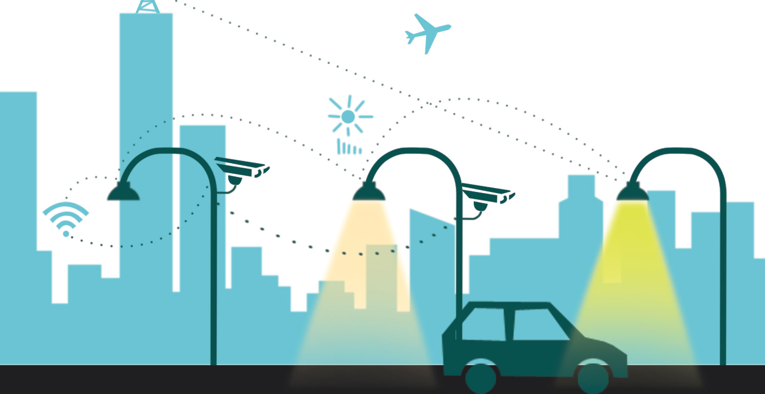
automatic light intensity control

Slide 3
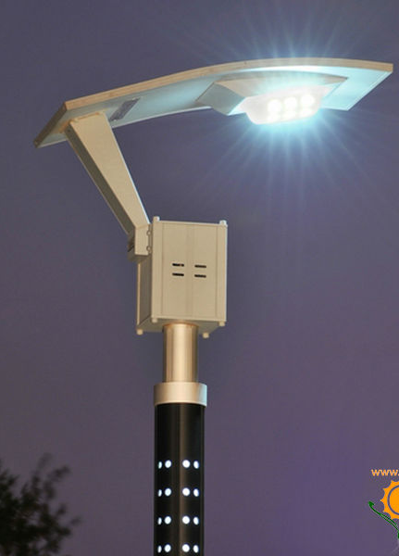
WHAT IS INTENSITY AUTOMATIC CONTROL?
THIS IS AN INNOVATIVE ENERGY SAVING SYSTEM THAT AUTOMATICALLY ADJUSTS LIGHT INTENSITY BASED ON EXTERNAL LIGHT SENSING

Slide 4
BROAD THRUST AREA:
Artificial intellence and machine learning
Automation

Slide 5

Lighting control system
A lighting control system is an intelligent network based lighting control solution that incorporates communication between various system inputs and outputs related to lighting control with the use of one or more central computing devices. Lighting control systems are widely used on both indoor and outdoor lighting of commercial, industrial, and residential spaces. Lighting control systems serve to provide the right amount of light where and when it is needed.
Lighting control systems are employed to maximize the energy savings from the lighting system, satisfy building codes, or comply with green building and energy conservation programs. Lighting control systems are often referred to under the term Smart Lighting

Slide 6
Lighting controls
The term lighting control system refers to an intelligent networked system of devices related to lighting control. These devices may include relays, occupancy sensors, photocells, light control switches or touchscreens, and signals from other building systems (such as fire alarm or HVAC). Adjustment of the system occurs both at device locations and at central computer via software programs or other interface devices.

Slide 7
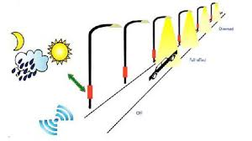
Automated control
Lighting control systems typically provide the ability to automatically adjust a lighting device's output based on:
Chronological time (time of day)
Solar time (sunrise/sunset)
Occupancy using occupancy sensors
Daylight availability using photocells
Alarm conditions
Program logic (combination of events)

Slide 8
Types
In the 1980s there was a strong requirement to make commercial lighting more controllable so that it could become more energy efficient. Initially this was done with analog control, allowing fluorescent ballasts and dimmers to be controlled from a central source. This was a step in the right direction, but cabling was complicated and therefore not cost effective.
There are two types of lighting control systems which are:
Analog lighting control
Digital lighting control

Slide 9
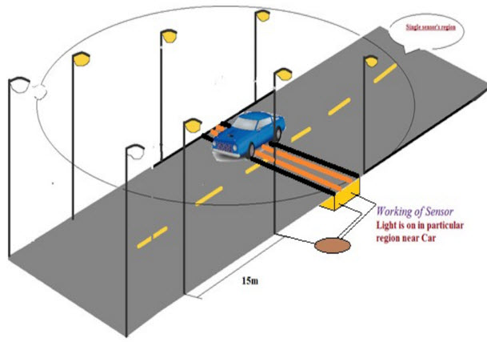
Auto intensity control of street lights :
Basic purpose of this project is to make street lights intelligent so that it can turn it on and off itself. Another feature of this project is that street lights intensity vary according to intensity of light and number of vehicles on road. Followings are the main features of this project :
Street lights turns itself on automatically during night or darkness. They turn themself off automatically during day time and during visible intensity of light.

Slide 10
CONT.
Street lights controls its intensity automatically according to intensity of light. For example in evening intensity of light start decreasing at the same time street lights start increasing its intensity. When there is no intensity of light in after evening, street lights turn themself on with full intensity till midnight at 12:00 am.
There is another feature included in this project that is vehicle detection. Infrared sensor circuit is used to detect vehicles on road. After 12:00am street lights start decreasing their intensity. At 1:00am street lights turn off automatically. After 1:00 am function of vehicle detection starts. If there is any vehicle on road after 1:00am, street lights turns on for 2 minutes. After that they turn off automatically. In other words, After 1:00am street lights turn on only if there is any vehicle on road. Otherwise they remain off. This process remains till morning. But after having visible intensity of light during moring street lights turn off automatically.

Slide 11
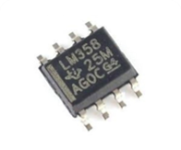
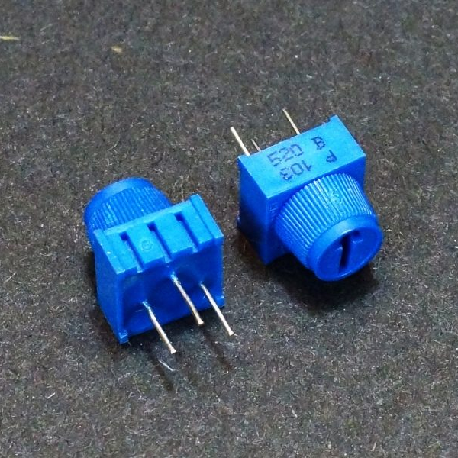
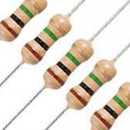
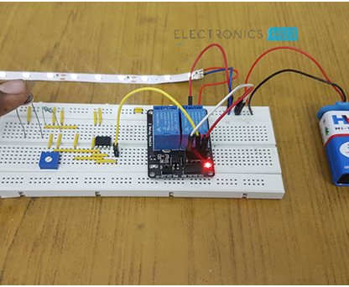
Components used in this Circuit
IC LM358
Variable Resistor
Potentiometer
Relay
Small LED Strip
Battery
LDR
Connecting Wires
Breadboard

Slide 12
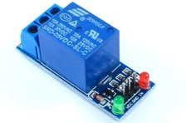


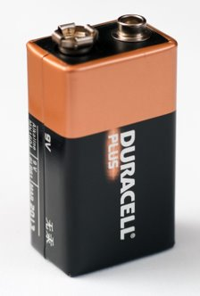
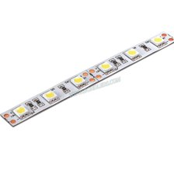
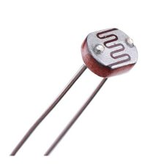

Slide 13
specification of components
LM358- it can be used as transducer amplifier
2. Variable resistor - A resistor of which the ohmic resistance value can be adjusted
3. POTENTIOMETER- it is defined as a 3 terminal variable resistor in which the resistance is manually varied to control the flow of electric current. A potentiometer acts as an adjustable voltage divider.
4. RELAY -A relay is an electrically operated switch.
5. LED- a light-emitting diode .a semiconductor diode which glows when a voltage is applied.
6. Battery- It is a power source consisting of one or more electrochemical cells.
7. LDR- it is a component that has a (variable) resistance that changes with the light intensity that falls upon it.

Slide 14
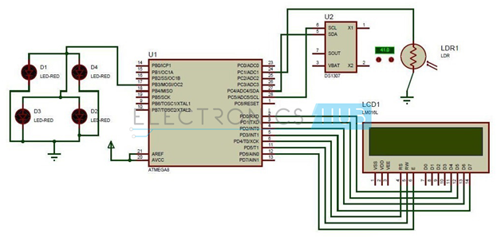
How Auto Intensity Control of Street Lights Circuit Works?
Initially power the circuit.
Time is displayed on the LCD display.
Place the LDR in darkness as the street lights switches on only when there is no light on LDR.
Now check the time if the time is between 9 pm to 2 am street light glows with full intensity.
From 2 pm intensity of the lights slowly starts decreasing and finally in early morning it glows with least intensity. When the light is sensed by the LDR lights are switched off automatically.
Code is written in such a way that up to 2 am lights will glow with full intensity. From then it slowly starts decreasing and finally it drops to zero in the morning

Slide 15

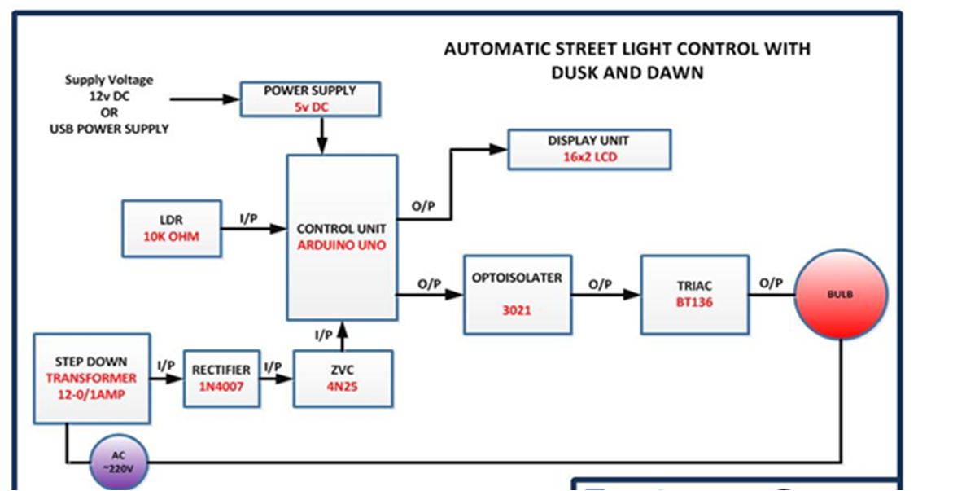
BLOCK DIAGRAM​​

Slide 16
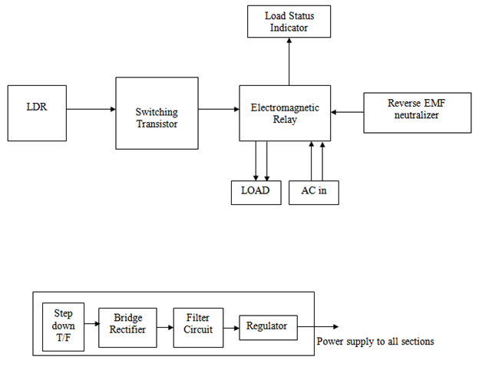
BLOCK DIAGRAM​

Slide 17
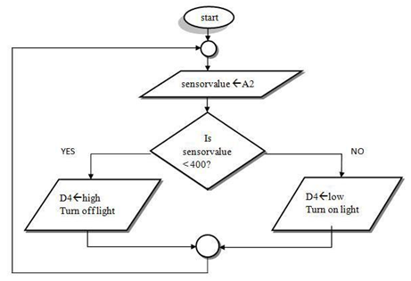

Slide 18
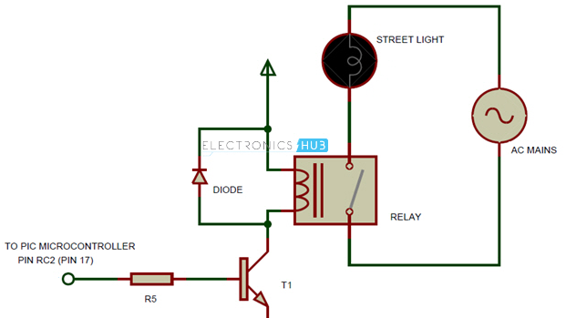
Auto Intensity Control of Street Lights Circuit Advantages
Power wastage can be reduced.
Using LED array reduces the cost.
Using of RTC and LDR produces accurate results.

Slide 19
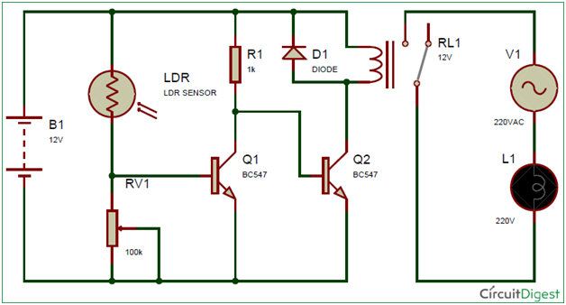
Advantages of auto intensity control of street lights :
No need to control street lights manually.
Electrical power saving.
Increases life time of street lights.
intelligent street lights.
vehicle detection.

Slide 20
Limitations of this Circuit
Even though energy is saved if there are any vehicles after fixed time, intensity of the light is low.
Maximum energy cannot be saved.

Slide 21
budget
LM 358(5pcs) - rs.225
Variable resistor - rs.3 or 1.85p
Potentiometer - rs. 49
Relay - rs.90- rs.100
Single LED - rs.25
Strip of LED - rs.12
Battery - rs.80
LDR - rs.35 So the estimated cost for our project is rs.624
Wires(1 pac) - rs.30
400 point bread board- rs.65
Total =rs.624

Slide 22


